Slide 1
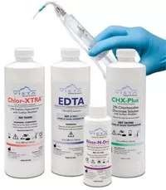
INTRA CANAL IRRIGANTS

Slide 2
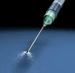
The complexity of root canal morphology presents a challenging objective to the endodontic community.
These complexities hampers the ability to thoroughly achieve pulp cavity disinfection.
The objective - is to remove all of the pulpal & dentinal debris from the root canal system.
Biomechanical preparation & chemical preparation are used concomitantly in order to debride the root canal system.
Biomechanical preparation attains free access to the apical foramen through the access opening and through the root canal system by mechanical means, which exposes, enlarges & shapes the root canal.

Slide 3
Ideal properties
Have a broad antimicrobial spectrum & high efficacy against anaerobic & facultative microorganisms organized in biofilms.
Dissolve necrotic pulp tissue remnants.
Inactivate endotoxin.
Prevent the formation of a smear layer during instrumentation or dissolve the latter once it has formed.
Should be systemically non toxic, non caustic to periodontal tissues & have little potential to cause an anaphylactic reaction.

Slide 4

Functions of irrigants
Antimicrobial activity.
Flushing action - debridement of the canal system.
Dissolution of necrotic and vital tissues.
Lubrication.
Removal of smear layer.
Bleaching action

Slide 5
TYPES OF IRRIGATING AGENTS
Sodium hypochlorite
Chealting agents - EDTA, R-EDTAC&EEDTA-C
Physiological saline
Hydrogen peroxide
Chlorhexidine di gluconate
MTAD (mixture od tertra cycline acid & detergent )
Ruddles solution with contrast media
Ozonated water
Tetracyclines
Iodines
Carvisol

Slide 6

Sodium hypochlorite
Strong oxidizing agent.
Clear straw colored.
5% of available chlorine (Grossman).
Commercially available CHLOROX pH 10.83 – 10.98

Slide 7
MECHANISM OF ACTION
Germicidal activity of sodium hypochlorite is because of formation of Hypochlorus acid.
Permeates cell wall and combines with the protoplasm.
Dissolves necrotic tissue because of high alkalinity.
Biopolymers like proteins are hydrolyzed into amino acids , - know as TISSUE SOLVENT

Slide 8
CONCENTRATIONS
0- 5.25%
0.5% - 5.25%
no difference in efficacy of 5.25, 2.5 & 1% NaOCl
2.5% solution – powerful solubalizer
Increasing the temperature , increases the efficacy
  Effectiveness of low concentrations of NaOCl can be improved by -
Larger volumes
Frequent change
Longer period of exposure

Slide 9
ANTIMICROBIAL EFFICIENCY
1 % NaOCl - found to kill both bacterial spores & HIV over a period of 30 minutes.
1 & 5% NaOCl effective against C.albicans.
1/10 concentrations of NaOCl effective against several anaerobic bacteria..
50% reduction in microbial count – 2.5% NaOCl, synergistic response with CHX (0.2%) lead to 80% reduction in microbial count.
Increasing the temperature from 22⁰C-37⁰C of a 2.6% NaOCl solution increased its tissue dissolving properties

Slide 10
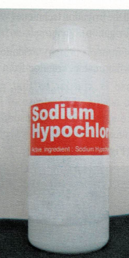
SODIUM HYPOCHLORITE ACCIDENT
The inadvertent injection of NaOCl into the soft tissues can elicit a violent and frightening response.
The cause of this emergency can be related to both the irrigant & the irrigation technique (wedged needle with forced irrigation
Mechanism from injury is primary oxidation of proteins followed by inflammatory reaction from the body.
This response is similar to that proposed in Angioneurotic edema with release of histamine / histamine like substance, a vasodilatation with subsequent transudation of plasma accompanied by hemorrhage.

Slide 11
The amount of tissue destruction depends on
Host response.
Volume of irrigation.
Concentration of irrigant.
Temperature of irrigant.
Spread of solution.

Slide 12
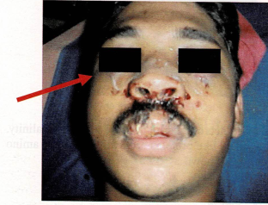
SEQUENCE OF EVENTS
Excruciating pain within 2-5 min
Burning sensation in affected area
Immediate swelling (ballooning) of the tissue in the area with spread to surrounding loose connective tissue.
Profuse bleeding episode either interstitially or through the root canal system.
Over the next few days, the pain subsides to a constant discomfort, swelling persists over a week and progressively subsides.
The interstitial hemorrhage may result in echymosis over the skin because of which the affected skin is discolored.

Slide 13
Treatment Modality
Stop treatment and give an explanation to the patient- Remain Calm Reassure patient.
Immediately irrigate with copious amounts of saline.
Pain control:
Immediately with a nerve block.
Prescribe analgesics.
Corticosteroids administration.
Consider incision and trephination if deemed necessary.
Antibiotics for 1 week
Cold compresses for first 6 hours followed by warm compresses and mouth rinses – 1 week.
Set up regular recall visits.

Slide 14
PREVENTION
Prevention of inadvertent extrusion of irrigant past apex. Measures include:
Express intra canal irrigant slowely
Passive needle placement in canal (especially if beveled)
Watch for flow back of irrigant.
Procedure to be performed under Rubber Dam.

Slide 15

CHELATING AGENTS (EDTA)
Nygaard - Ostby - 1957 introduced EDTA with the following formulation as an adjuvant in root canal therapy.
COMPOSITION
Ethylene diamine tetracetic acid (disodium salt)- 17.0gm
Distilled water- 100 cc
5/N NaOH- 9.25 cc
EDTA is an insoluble, odorless, crystalline while powder; it is relatively non toxic & only slightly irritating in weak solutions.
Has a pH of 8.3

Slide 16
FUNCTIONS
Lubrication
Emulsification
Smear layer removal
Dispensed in two forms
Viscous ,
Aqueous
Canal preparation
Final flush – cleaning & shaping –smear layer removal

Slide 17
EFFECTS OF EDTA
Has dentin dissolving effects
Reduces the time necessary for debridement
Aided in enlarging narrow/ obstructed canals.
Non corrosive on instruments.
To bypass fragmented instruments
Antimicrobial
Self limiting action
Neither bactericidal nor bacteriostatic
Inhabits the growth of & eventually destroyed bacteria by the process of starvation
EDTA forms a stable bond with calcium & the deposited solution can dissolve only a certain amount of dentin
When all chelating ions have reacted, an equilibrium will be reached; then no further dissolution will takes place
17% EDTA - recommended for 1min as a final rinse followed by NaOCL irrigation

Slide 18
Formulations of EDTA
1. R-EDTA - EDTA with cetrimide ( cetyltrimethyl ammonium bromide )
Cleans the canals effectively of the inorganic portion , with organic material being left behind
2. Quaternary ammonium bromide – Cetavlon was added to EDTA
To reduce surface tension & was called EDTAC , Increases the wetting effect on the canal walls & permitted deeper penetration into the tubular irregularities
3. EDTA-T ( With sodium lauryl sulfate )
4. SOLUTION OF EDTA & ETHYLENEDIAMINE( a strong organic solvent)

Slide 19

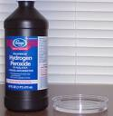
HYDROGEN PEROXIDE
1943 - Grossman - 3% Hydrogen peroxide as an Endodontic irrigant - recommended to be used alternately with Sodium Hypochlorite.
Disinfecting and bleaching effects of both solutions are moderate to the anaerobic pathogens.

Slide 20
Their interaction in the canal produced a transient but energetic effervescence because of the production of nascent oxygen.
This was responsible for forcing debris and microorganism out of the canal.
H₂O₂ does not posses tissue dissolving properties, nor is it a lubricant. Limited antimicrobial action only.
This was the coupled with the solvent action of NaOCl on the organic debris.
When irrigating with H₂O₂ the last irrigant used should be NaOCl to prevent any nascent oxygen from being trapped in the canal

Slide 21
CHLORHEXIDENE (CHX) DIGLUCONATE (2% )
Chlorhexidene in the form of a salt (i.e.gluconate , acetate or hydrochlorate) - used since 1950’s - as an oral antiseptic in the form of a mouthwash, sub gingival irrigant, gel, toothpaste & chewing gum.
It is a cationic bisbiguanide with optimal antimicrobial action
pH 5.5-7.0
Concentrations used – 0.12% , 0.2% & 2%

Slide 22
Antimicrobial activity
Possesses a broad spectrum of activity against gram +ve & gram -ve bacteria, fungi, bacteria , bacterial spores, lipophyllic virus, dermatophytes
Mechanism of Action – 2 fold (Hennessey 1973)
1. High Concentrations: Bactericidal
Chlorhexidine penetrates the cell wall & causes precipitation / coagulation of cytoplasm probably caused by cross- linking.

Slide 23
  2. Low Concentrations: Bacteriostatic.
Positively charged molecules of chlorhexidene bind readily to the negatively charged cell wall, mainly to phosphate groups in LPS, & carboxyl groups in proteins.
It therefore interferes with membrane transport initialing a leakage of low molecular weight substances.

Slide 24
Acts by adsorbing into the cell walls of the micro-organisms & causing leakage of intracellular components.
Bacteriostatic effect is considered to be more important since the bound chlorhexidene molecule is released slowly over 24 hours.
Effective action against E. faecalis.
Substantivity – protien bound chx releases slowly leading to prolong activity .this phenomenon is known as substantivity & allows long duration of anti microbial action against a broad spectrum of bacteria & fungi

Slide 25
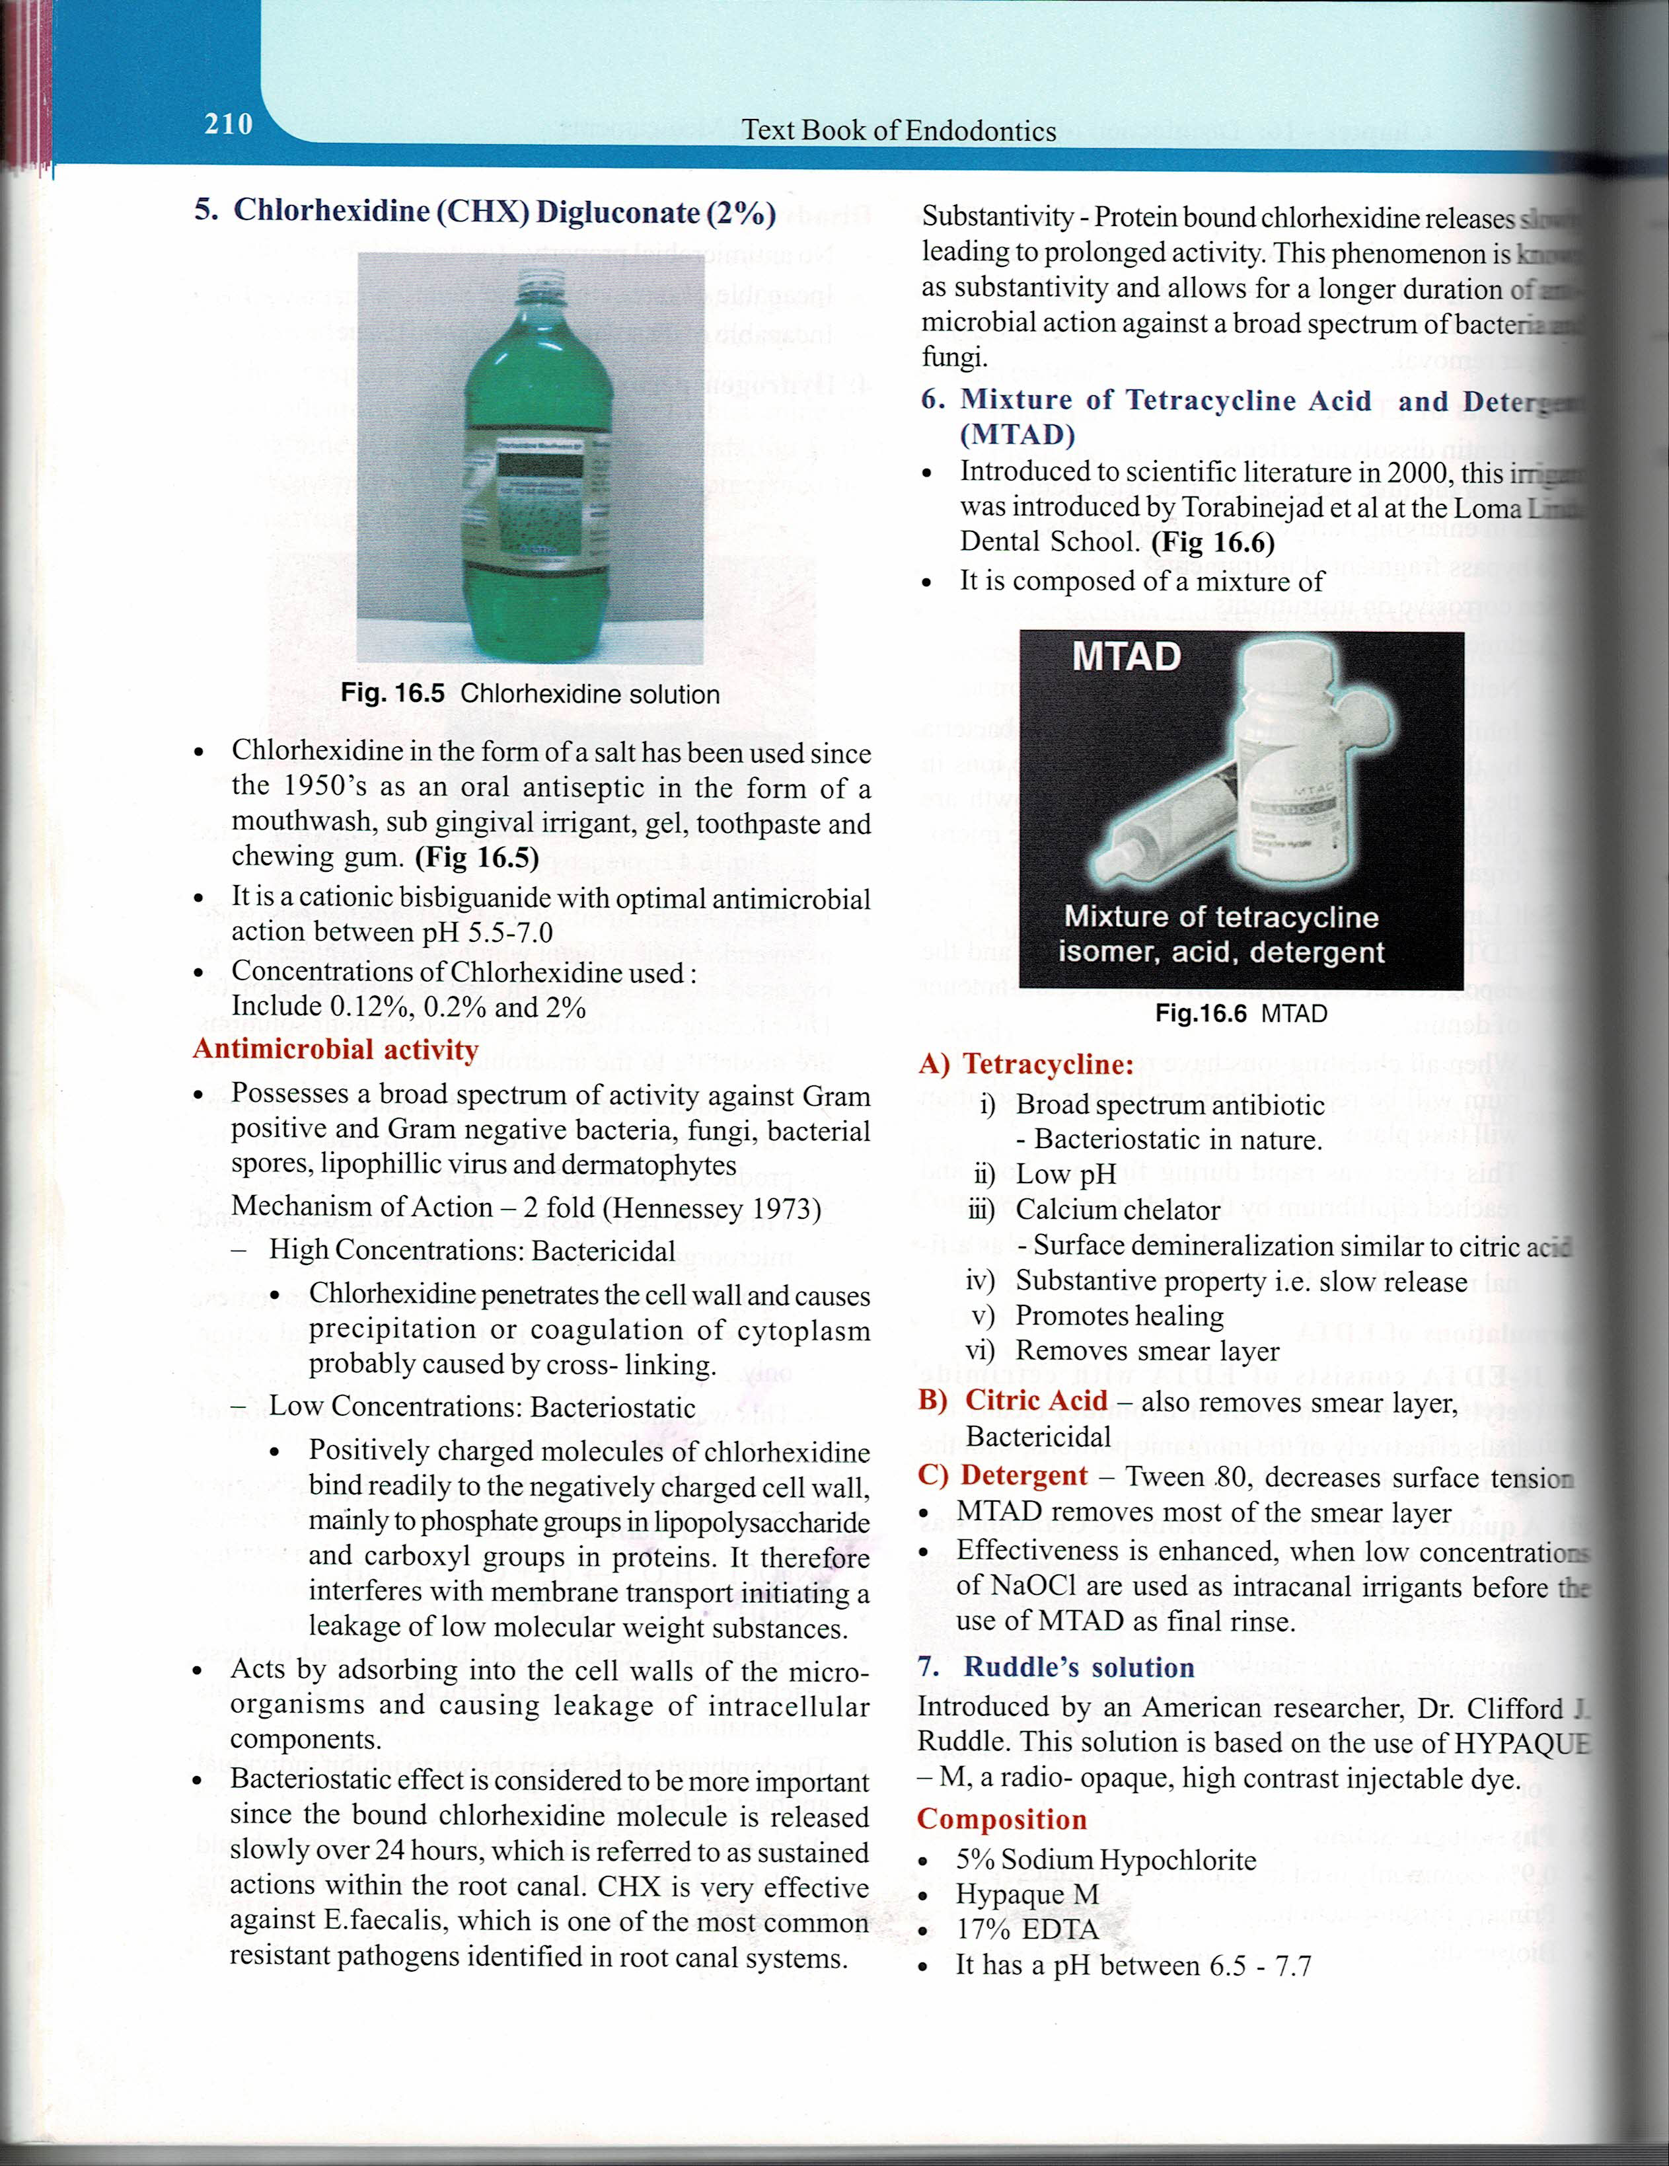
Mixture of tetracycline acids & detergent (MTAD)
Introduced to scientific literature in 2000, this irrigant was introduced by Torabinejad et al at the Loma Linda Dental School.
It is composed of a mixture of
A) Tetracycline:
i) Broad spectrum antibiotic , bacteriostatic in nature
ii) Low pH
iii) Calcium chelator- surface demineralization similar to citric acid
iv) Substantive property ie., slow release
v) Promotes healing
vi) Removes smear layer
B) Citric Acid – also removes smear layer, Bactericidal
C) Detergent – Tween 80, decreases surface tension.
MTAD – removes most of the smear layer
Effectiveness is enhanced –when low conc of NaOCL – used as intra canal irragants before use of MTAD as final rinse

Slide 26
RUDDLE’S SOLUTION
Introduced by an American researcher, Dr. Clifford J. Ruddle.
This solution is based on the use of HYPAQUE – M, a radio- opaque, high contrast , injectable dye
5% Sodium Hypochlorite.
Hypaque M.
17% EDTA
COMPOSITION
pH between 6.5 - 7.7
Solvent action and radio-opacity similar to Gutta Percha - HYPAQUE
Improved penetration because the tensioactive agent , decreases the surface tension besides removing the smear layer.

Slide 27
OZONATED WATER
Use of ozonated water for treatment of endodontic infections- suggested by Nagayoshi et al - 2004.
observed that ozonated water had nearly the same antimicrobial activity as 2.5% NaOCl during irrigation.
Ozonated water is a powerful antimicrobial agent against bacteria, fungi, protozoa and viruses.

Slide 28
Ozone in aqueous / gaseous phases has a strong oxidizing power with reliable microbial effects.
Ozone destroys cell walls & cytoplasmic membranes of bacteria & fungi.
Increased permeability leads to ingress of ozone which cause microbial death.

Slide 29

TETRACYCLINES
Include
Tetracycline HCl.
Minocycline.
Doxycycline.
Broad spectrum antibiotic.
Enhance healing after surgical periodontal therapy.
Low pH in concentrated solutions & thus can act as calcium chelators. This may cause root surface demineralization comparable to citric acid.
Substantivity of these antibiotics allows them to be absorbed & released gradually from tooth structures.

Slide 30
CARISOLV
Advocated for chemomechanical removal of infected carious dentine.
2 syringes: one containing 0.5% NaOCl & other containing 0.1M amino acids, NaCl, NaOH & erythrocin.
Amino acids bind with chlorine to form high pH chloramine which is a potent disinfectant with tissue solvent activity.
Potential for Carisolv to clean root canals is that NaOCl is present in gel form.

Slide 31
METHODS & TECHNIQUES OF IRRIGATION
Walton & Torabinejad stated that “Perhaps the most important factor is the delivery system & not the irrigation solution per se”.
The most common method of delivering irrigant into the canal is with the aid of a syringe to which is affixed a needle.
A 5ml syringe of the disposable Leur Lok twist mechanism is the preferred one. In this case the needle will not to be dislodged when the plunger of the syringe is displaced.

Slide 32
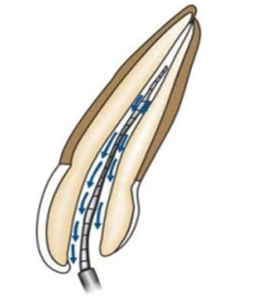
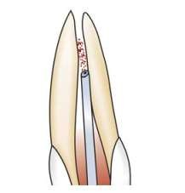
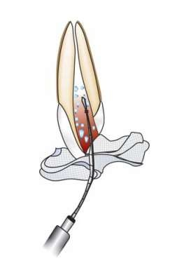
GAUGE OF THE NEEDLE
Gauges ranging from 21 gauge to 30 gauge needles .
Since irrigation of apical third requires the needle to be in it’s proximity for adequate effect , the canals contents should be flushed with a 27-30 gauge needle placed in apical third.
The needle should be bent to an obtuse angle to allow for easier access & entry to the orifice. This bend is to be placed closer to the hub of the syringe

Slide 33
Designs of Needles
Open ended blunt needles
Beveled needles
Blunt ended side venting needle (ProRinse)
Notched tip (Monojet – 27 gauge)
Perforated needle –Endovage (Goldman & others

Slide 34
Recent Innovation: STROPKO IRRIGATOR this irrigation system combines the delivery & recovery of irrigant in one probe.
The needle delivers the solution and an aspirator held in the same sheath retrieves the delivered irrigant.

Slide 35
OTHER METHODS OF DELIVERY
  ENDO -IRRIGATOR
A system that delivers various kinds of on-line irrigants from one in –office air pressurized bottles at the push of a button.
Various gauged cannuli can be selected & attached onto the irrigating handpiece.
Allows clinicians to conveniently choose, dispense & more effectively irrigate the root canal system.

Slide 36
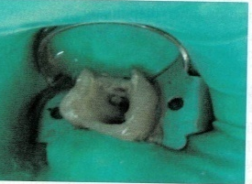

THE TECHNIQUES:
1. Secure rubber dam isolation
2. Fill syringe via hub irrigant stored in a dappen dish by the chairside.
3. SOMMER’S TECHNIQUE
Place a few drops of irrigant in the pulp chamber , then “Whirlpool” the solution into the canal with a small file.
4. GROSSMAN’S TECHNIQUE
flood the pulp chamber with the irrigant . This served as a reservoir of irrigant to replenish the one present in the root canal as it was being instrumented.
5. When the needle is introduced into the canal & meets resistance , it is withdrawn a few mms to prevent it from wedging & forcing the irrigant into periapical tissues.

Slide 37
6. Once irrigant delivery starts, look for the backflow of the irrigant from the canal orifice.
7. The hand holding the irrigating syringe is always kept in motion when dispensing irrigant.
8. Files potentially carry irrigant progressively deeper into the canal by surface tension. In small canals, the files displace the irrigant. When the instrument is withdrawn, the irrigant usually flows into the space the file occupied.
9. Clinicians should irrigate copiously, recapitulate & re-irrigate after each instrument size.
10. Besides using an aspirator, Grossman suggested the use of a gauze sponge held against the tooth to absorb the backflow of the irrigant.
11. Once the shaping & cleaning is accomplished, the irrigant is aspirated from the canal with syringes & subsequently dried with paper points.

Slide 38
Endovac
It is a negative pressure irrigation system found to increase the efficiency of irrigation at the working length to avoid extrusion and complications
Using a combination of a macro & micro cannula attached to the suction device
Irrigant introduced into the pulp chamber by the master delivery tip pulled by negative pressure down the canal into the tip of the cannula & removed through the suction hose – aviods the entrapment of air & also safety delivers irrigant uptil the working length

Slide 39
ENDO SONICS & IRRIGATION:
At the US Navy Dental Center, Martin & Cunningham developed a system which used ultrasonics for preparing the root canal.
The power source they employed was a magnetostrictive unit. Recently piezoelectric units have also been used.
This technique was termed a “SYNERGISTIC SYSTEM” because the instrument abrades dentin delivers a copious flow of irrigant to the tip of the instrument
The instrument tip is moved 0.001-0.004 of an inch through a push pull motion of the handpiece at a frequency of 20-25 thousand Hz
A continuous irrigant flow is provided at 45ml/minute.

Slide 40
MECHANISMS INVOLVED
1. CAVITATION
When a vibrating object is immersed in a fluid, oscillations are set up in the liquid.
During the rarefaction phase, the liquid can fail under stress & form bubbles. (This is termed PSEUDOCAVITATION by Cameron)
During the next positive pressure phase, these vapor filed cavities collapse implosively producing a high temperature and pressure of the gas still contained within the cavity.
These high temperatures & pressures in turn result in free radical generation & radiate shock waves from the collapse which leads to it’s WATER HAMMER ACTION on solid surfaces.

Slide 41
2. ACOUSTIC STREAMING
Is the more prominent method by which the action has been explained.
Definition: Rapid movement of particles of fluid in a vortex like motion about a vibrating object but may also be associated with small gas bubbles set into oscillation by the fluctuating pressure field generated by the file.
Streaming pattern where liquid was transported from the apical end to the coronal end of the file in a region very close to the file.

Slide 42

ULTRASONICS & MICROBRUSHES:
Bristle materials & bristle attaching techniques have led to the creation of an endodontic microbrush.
Bristles can be attached to either - Braided wires / Flexible, plastic cores
Fabricated as either rotary / ultrasonic endobrushes
Contain 16mm of bristles with D₀ bristle diameters of 0.40, 0.50, 0.60, 0.80mm.
Have Non standardized Gutta Percha master cone tapers: Fine ,Medium ,Large
Used in conjunction with NaOCl & EDTA to produce clean canals.

Slide 43
Photo activated disinfection (PAD)
Combination of photosensitizer solution & low – power laser light
Photo sensitizer - colored & adheres to microbial cells
Low power laser hits & inactivates the microbial the microbial cells
Laser lights activates the photo sensitizer & creates a cascade of energy , transfer & release free radicals – this inactivates the virulence factors & cause DNA damage
PAD needs maximum of 150 seconds to act unlike sodium hypochlorite

Slide 44
Different types of dyes are used which are absorbed by microorganisms - Tolonium chloride , Methylene blue peak , Nose bengal peak absorption , Sodium phosphate buffers
Effective against against all gram negative organisms

Slide 46
Photo induced photo acoustic streaming (PIPS)
Laser tip has to be placed 1mm from the apex & other traditional techniques require the placement of the tip 5mm from the apex
the PIPS eliminates the need to introduce the tip into the canal system due to profound & distant effect .
Tip has to be placed in the coronal portion of the pulp chamber & left stationary
2940nm Er :YAG laser – 14mm long, 400 micron diameter tapered tip is used
Final 4mm –stripped from the back to allow for greater emission of energy compared to the frontal tip , this allows for improved lateral diffusion of low energy & enhanced photo- acoustic waves

Slide 47
The solutions of the irrigant varies depending on the need of a particular care; the most commonly used are Chlorhexidine , NaOCL, Hydrogen Peroxide , Ozonated water ,Saline in different combinations

Slide 48
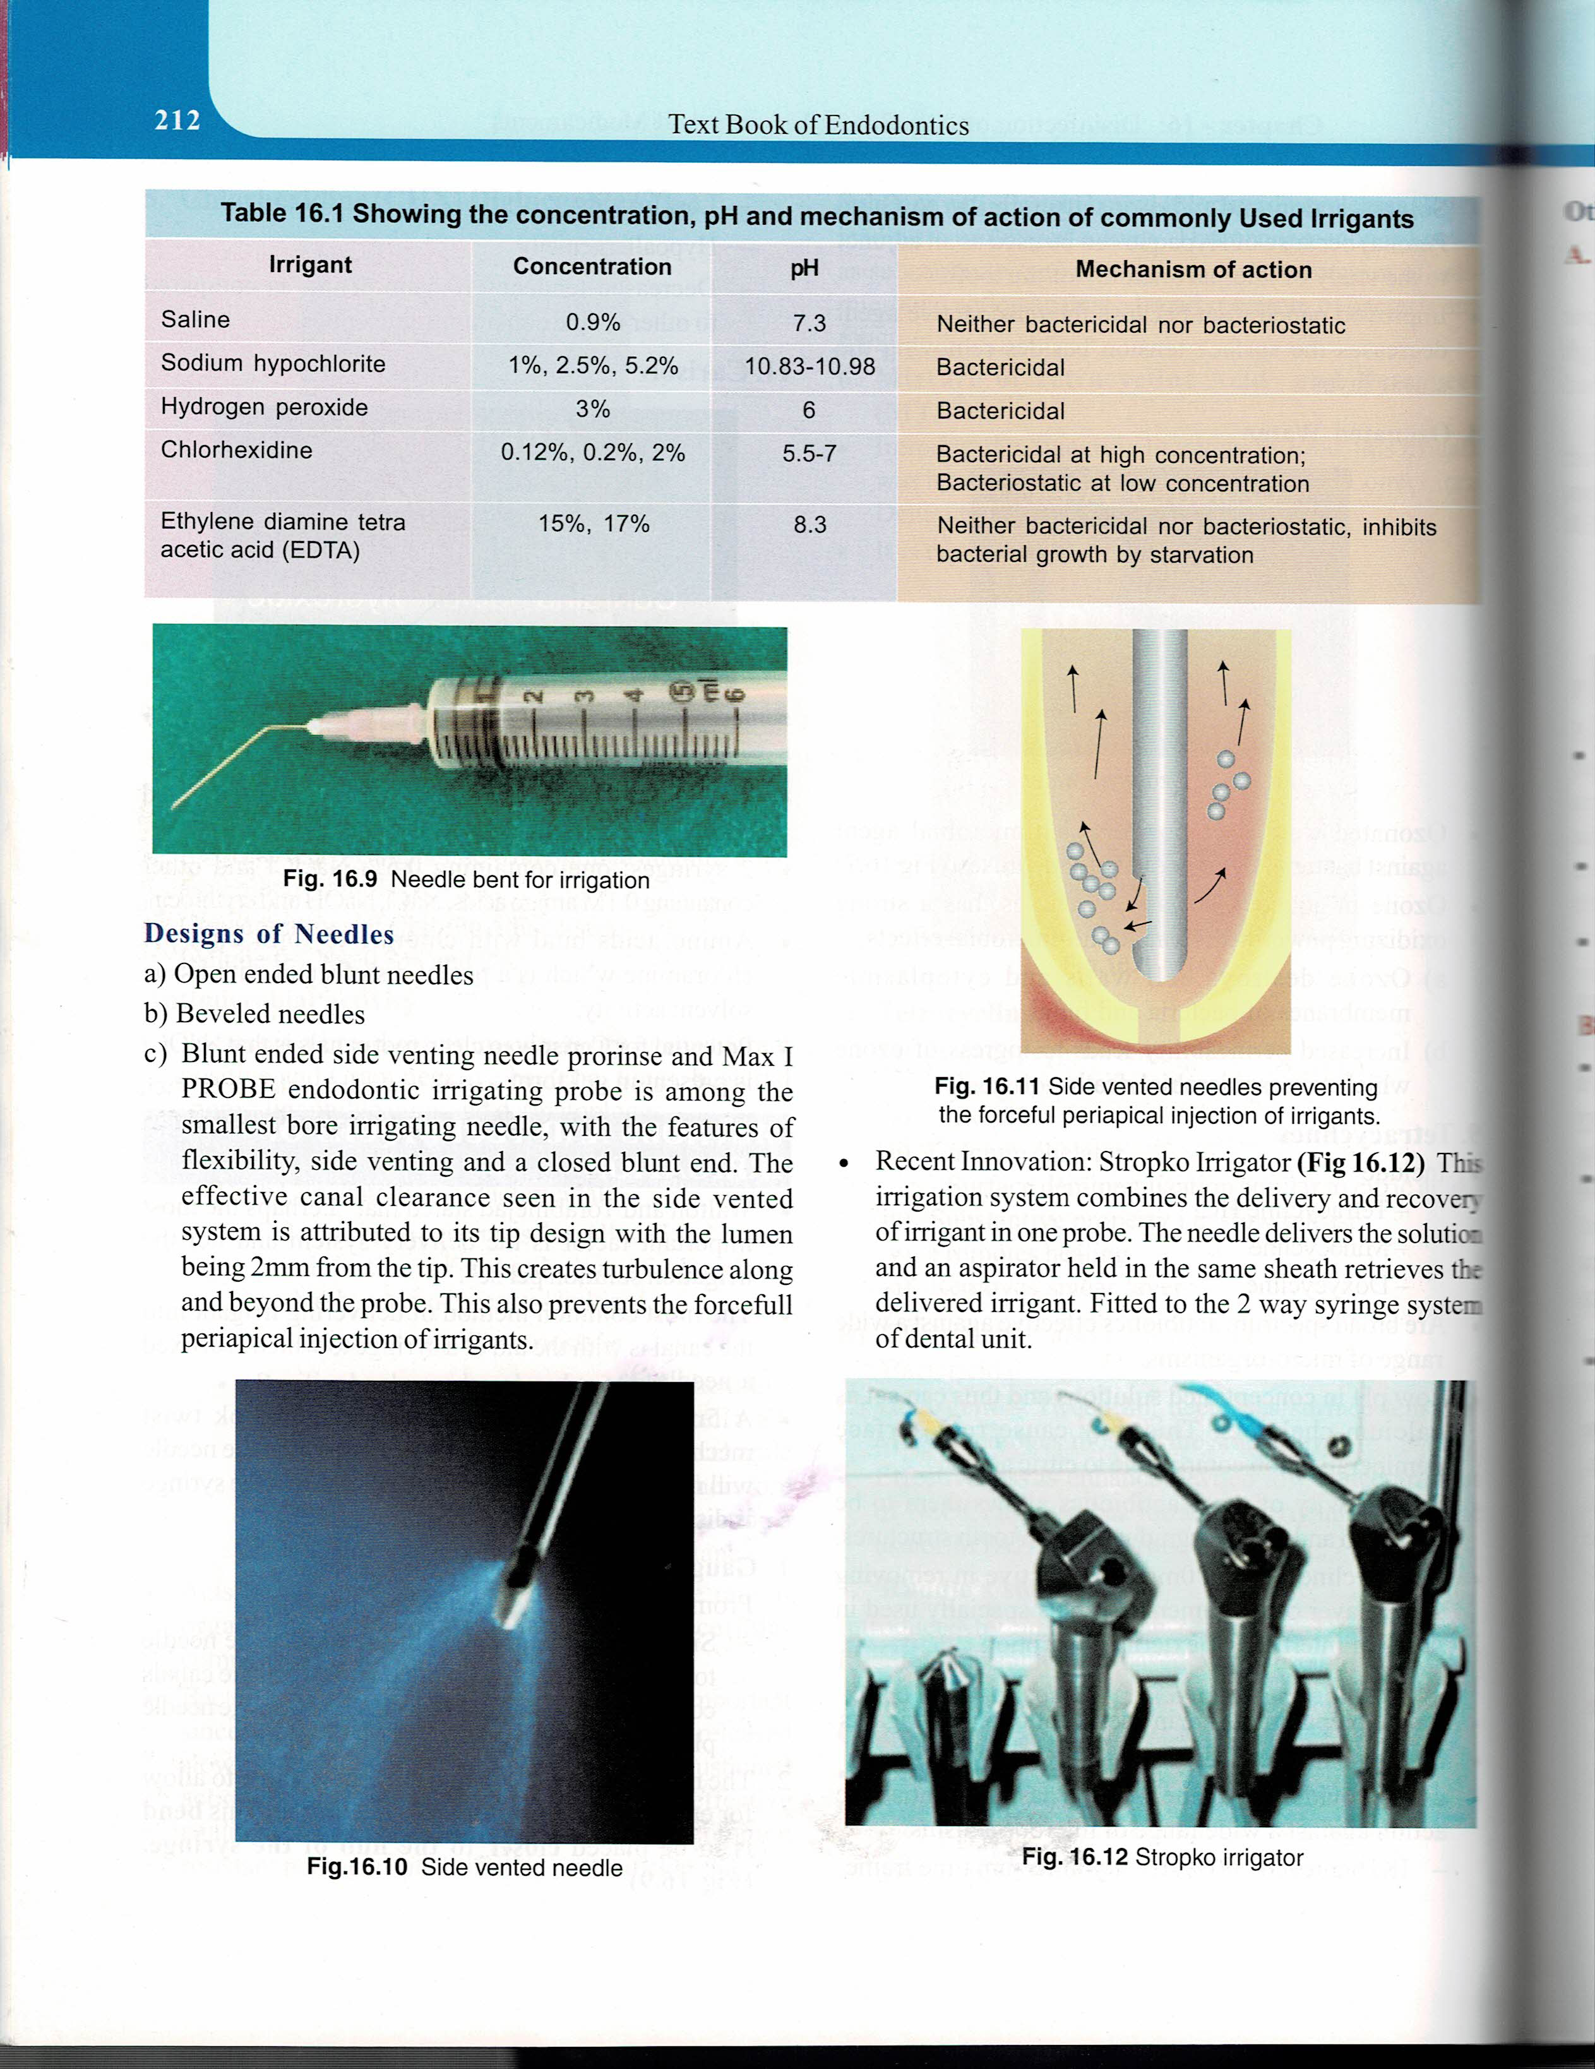
The concentration , pH & mechanism of action of commonly used irrigants

